Slide 1
Uber Analytics
Tasfia Tasneem

Slide 2

About the Dataset
Uber Analytics 2024
Ride-Sharing Data
Contains around 150,000 rows
Data includes information about each ride, including
  Customer and Driver Ratings
  Ride Completion
  Total fare
  Type of Vehicle
Detailed information on Uber Rides, from Fares to Distance
Curious about what exactly influences Customer Ratings

Slide 3
What Factors Influence Customer Ratings?

Slide 4
Dataset Characteristics
The dataset contains around 150,000 rows (individual ride records) and 21 columns (variables).
Variables of interest include:
Customer.Rating - measure of customer satisfaction (1-5 scale)
Driver.Rating - measure of satisfaction with Driver (1-5 scale)
Vehicle.Type – identifies types of vehicles used (e.g., eBike, Sedan, Auto, Bike)
Booking.Value – represents the total fare for the ride (Dollars)
Ride.Distance - Distance Covered during ride (km)
Average VTAT - Average time for driver to reach pick up location (minutes)
Average CTAT - Duration between pickup and destination (minutes)

Slide 5
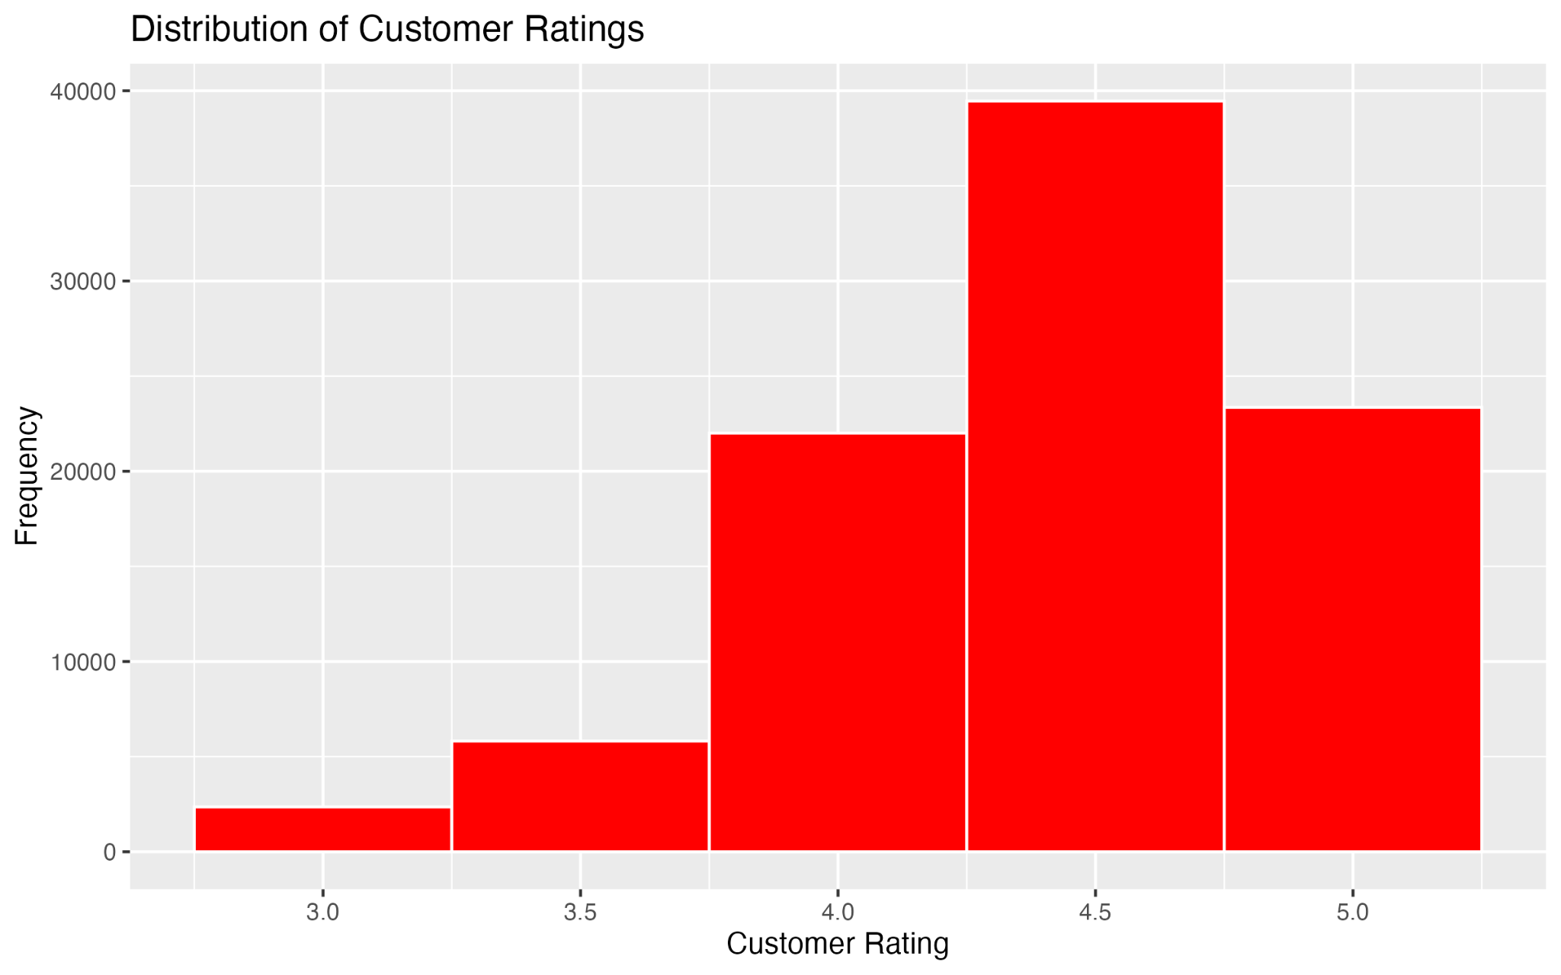
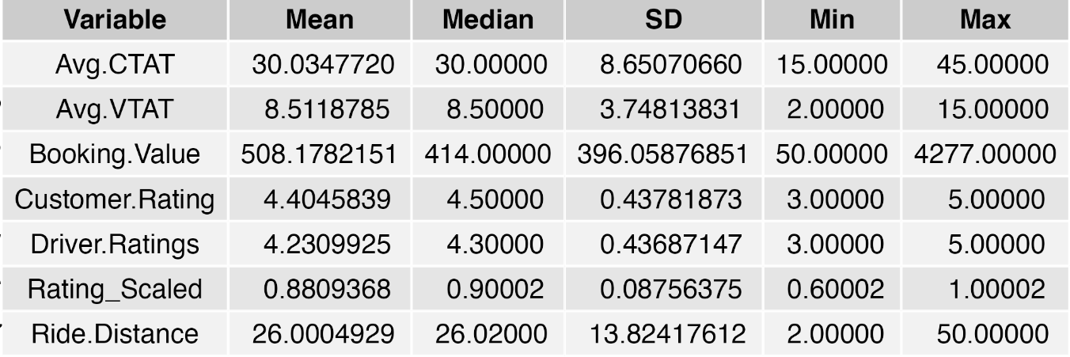
Graphs

Slide 6

Data Processing
Selected Variables of Interest
Inspected and prepared the data
  Converted values to numeric
  Filtered out rows with no Customer Rating
Generated summary statistics for variables
  Visualized Distributions
  Visualized Box and Whisker Plots

Slide 7

Analysis
Examined Distribution graphs
Used Nonparametric approaches instead
  Spearman Correlation instead of Pearson
  Kruskal-Wallis Test: Customer Ratings vs Vehicle Type
Linear Regression
Ordinal Logistic Regression
Used other visualizations such as histograms and boxplots

Slide 8
Results
None of the variables significantly affected Customer Ratings
Customer Ratings were strongly skewed left
  Vast majority of reviews were between 4 and 5
  Very few low ratings
  Violated normality
Even non-parametric approaches such as Spearman and Kruskal-Wallis correlations could not show any relationships
Ordinal Logistic Regression also failed to find significant relationships
Factors outside of the variables may have influenced Customer Ratings

Slide 9

Final Task
Since the data was heavily skewed towards positive ratings, I would add more variables to contextualize the data
Variables such as:
  Driver Behavior
  Ride Comfort
  Perception of Safety
  Weather conditions
  Traffic conditions
These factors may explain Customer Ratings better than the current existing variables

Slide 10

Reflection
I learned that data science is about asking questions, challenging assumptions, and adapting
Data are rarely clean and ready to use.
Data may not always fit neatly into a model
As for programming, I got more comfortable with R

